Slide 1


Literature Review
OMAIR BILAL
2023-07-21
1

Slide 2

Contents
Liu, Jiajia, et al. "Space-air-ground integrated network: A survey." IEEE Communications Surveys & Tutorials 20.4 (2018): 2714-2741.
Introduction to Satellite-air-ground integrated network (SAGIN)
Challenges and ongoing research in SAGIN
Overview of Physical Layer Features and Spectrum Allocation
Existing work related to System Integration and Performance Analysis
Essential purpose of Coverage Computation Module with SAGIN
Integration of Coverage Computation Module with SAGIN
How to perform the integration of Coverage Computation Module with SAGIN

Slide 3
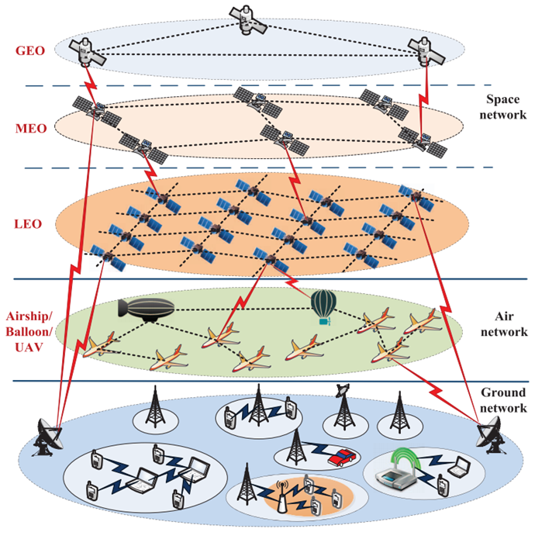
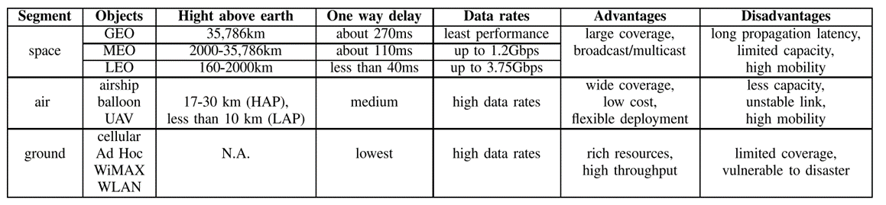
SAGIN
SAGIN is a network system that combines communication technologies from space (satellites), the air (aircraft), and the ground (terrestrial infrastructure). SAGIN provides reliable and high-capacity connectivity.
By integrating satellites, aircraft, and ground-based infrastructure, it improves coverage, data speed, and network resilience
TABLE -I
Comparison of Different Networks
Fig. 1. An architecture for space-air-ground integrated network(SAGIN).

Slide 4
Challenges in SAGIN
Challenges in SAGIN:
Because of the mixed, self-organizing and changing nature of the SAGIN, there are many challenges
Traffic distribution
Mobility Management
Route scheduling
Spectrum allocation and optimization
Load balancing
Heterogeneous Network Integration
Bandwidth
Latency
Security and privacy
Handover Management is also a challenging issue
End-to-End (E2E) QoS, etc.
Ongoing research in SAGIN:
Research progress in SAGIN with the emphasis on:
Protocol optimization
Resource allocation and optimization
Performance analysis
Mobility management
Inter-segment operation
Handover Management
Routing and Network Design
Interference Management and Spectrum Sharing
Quality of Service (QoS)

Slide 5
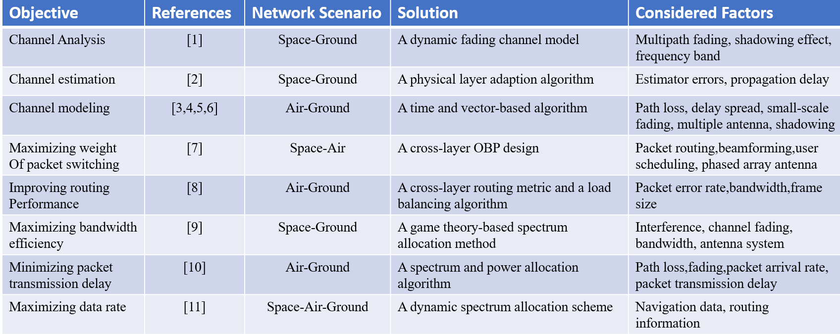
Physical Layer Characteristics and Spectrum Allocation
TABLE-IV
Paper References Related to Physical Layer Characteristics and Spectrum Allocation
Traditional spectrum allocation assumes static channels, neglecting the high mobility of LEO satellites and UAVs in SAGIN.
The dynamic nature of propagation channels requires flexible spectrum allocation schemes.
Developing a dynamic and flexible spectrum allocation schemes is crucial for achieving higher spectrum efficiency in SAGIN.

Slide 6
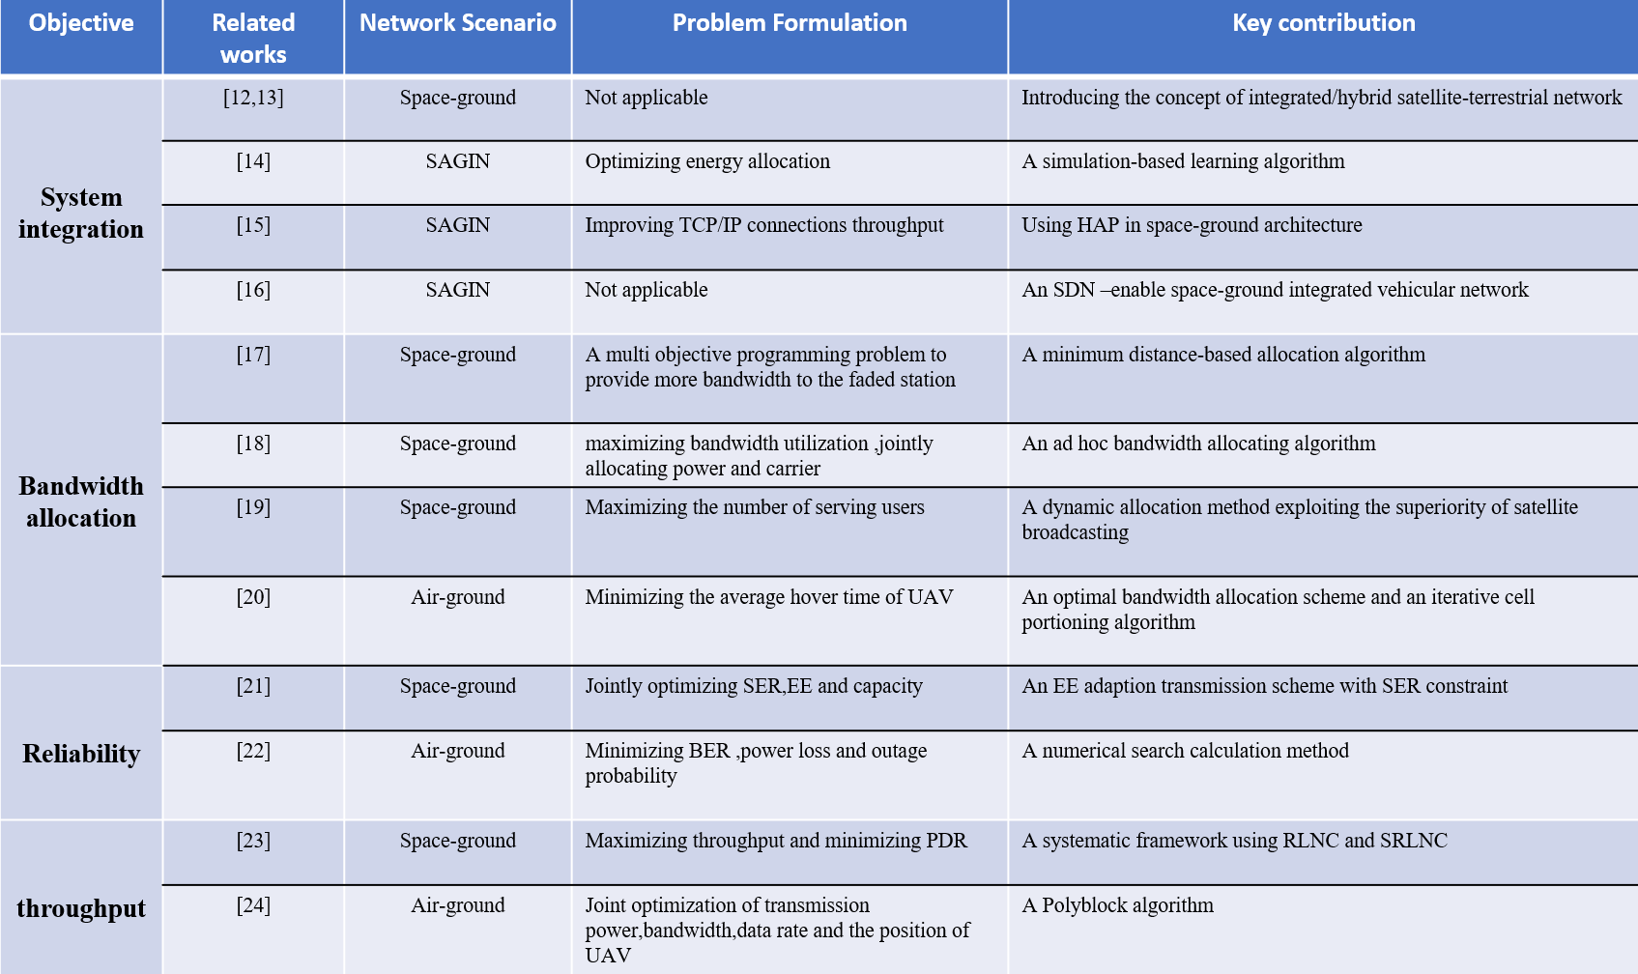
Existing work related to System Integration and Performance Analysis
TABLE-V
Summary of Related Works on System Integration and Performance Analysis

Slide 7
Essential purpose of Coverage Computation Module with SAGIN
In a SAGIN, utilizing a Constellation Computation Coverage Module serves several essential purposes:
A “Coverage Computation Module" calculates the minimum number of satellites required to completely cover an area of interest by using while-loop based iterative method.
Optimal Coverage: This module can help determine the optimal positioning of satellites to ensure maximum coverage and improve network performance.
Resource Allocation: It improves network resource allocation. The network can better distribute resources by determining where and when satellites will provide coverage.
Network Resilience: The module aids network resilience. The satellite constellation's coverage can inform redundancy planning. If one satellite fails or is not available, other satellites replaced with failed one.
Load Balancing: It can help in load balancing. If the module predicts heavy demand in a particular area, the network can distribute the load among various satellites, airborne assets, or ground-based assets.
Network Planning and Expansion: For future network planning and expansion, understanding the existing coverage capabilities is essential. This module can provide insights for long-term planning.

Slide 8
Integration of Coverage Computation Module with SAGIN
SAGIN can be integrated with a constellation Coverage Computation Module. Integration can improve overall system functionality.
The Constellation Coverage Computation Module evaluates coverage quality, optimizes system design, identifies gaps, evaluates performance, visualizes patterns, and optimizes dynamic resource allocation in satellite communication systems. It enables reliable and efficient coverage over desired areas.
Integrating the Coverage Computation Module with SAGIN optimizes network planning, evaluates link performance, allocates resources, and enhances network efficiency, coverage, and reliability.

Slide 9


How to Integrate Constellation Coverage Computation Module with SAGIN
Step 1 Step 2 Step 3 Step 4
Data Integration
Satellite positions, coverage patterns, ground station locations, and network topology.
Coverage Modeling
Satellite positions, antenna characteristics, propagation models, and interference.
Performance Evaluation
Coverage area, signal strength, and quality. Identify areas with coverage gaps or suboptimal performance.
Optimal Satellite Configuration
Optimize the placement and configuration of satellites by adjusting satellite positions, orientations, or antenna parameters to maximize coverage efficiency.
Validation and Optimization
Continuously optimize the module
performance through testing, simulations
and real-world measurements to further
improve coverage efficiency.
Real-time Monitoring and Adaptation
Implement mechanisms to monitor the performance and adapt the coverage as needed through dynamic adjustments to satellite positions, power level, antenna.
Resource Allocation
Allocate bandwidth and power using coverage model and performance measure. Optimize resource allocation for integrated network coverage and efficiency.
Network Planning
Integrate the optimized satellite configuration into SAGIN network planning to enhance overall coverage and connectivity.
Step 8 Step 7 Step 6 Step 5

Slide 10
Conclusion
This literature review focused on a survey of recent research on SAGIN, which has gained attention from academia and industry.
It provides an overview of studies focusing on the integrated network's segments, including cross-layer design, resource management, spectrum allocation, system integration, and network performance analysis.
We also discussed the integration of coverage computation module with SAGIN and how it can improve the overall system efficiency .

Slide 11


